Slide 1
Dynamic Modelling Simulation and Control of Asymmetrical Multi-Rotor UAVs
Interim Report Interview
Akinola Alexander Dada

Slide 2
Background
Unmanned Aerial Vehicle (UAV) are aerial systems which are not directly controlled by a human onboard the vehicle.
Focus on multi-rotor UAVs which have the ability to perform VTOL, stationary and low speed flight.
Wide ranging applications such as: administration of substances in precision agriculture, inspection of standing structures, wide area surveillance.
Inherently unstable thus to ensure efficient control schemes, mathematical modelling is necessary

Slide 3
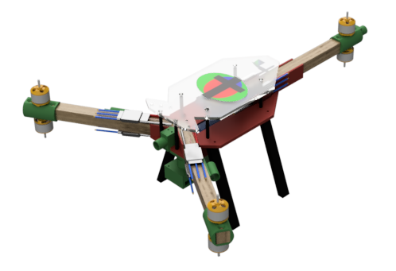
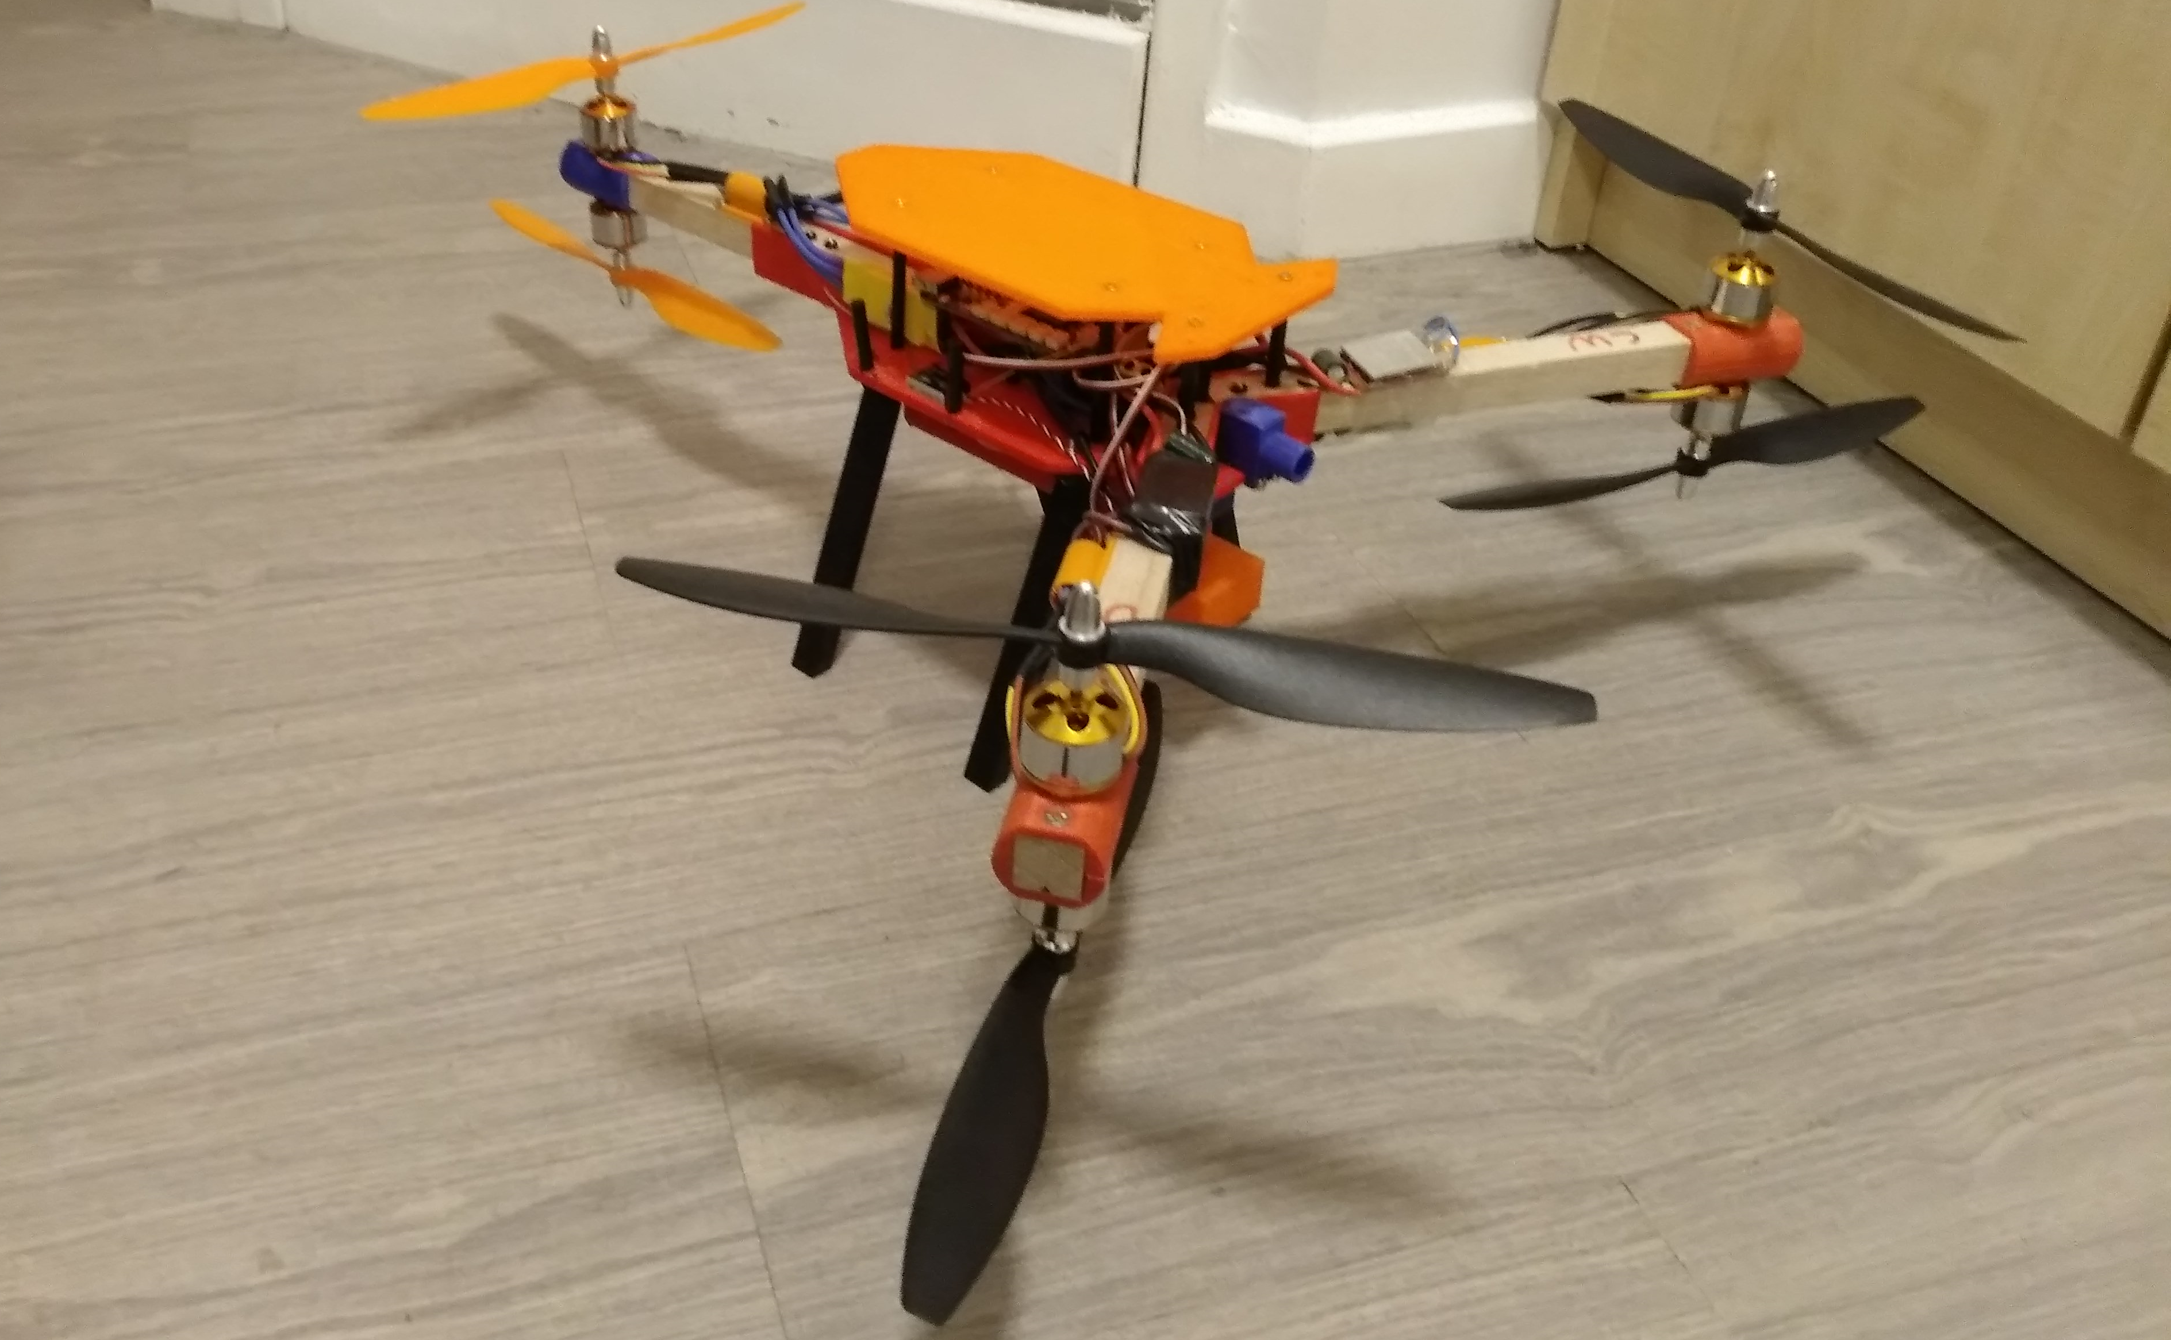
UAV

Slide 4
Aims and Objectives
Basic Objectives
Advanced Objectives
Develop a mathematical model of the multi-rotor aircraft.
Develop dynamic simulation
Develop feedback control laws: PID and LQG.
Investigate feedback control laws in simulation
Develop flight control software
Implement on embedded microprocessor unit.
Implement controller unto multi-rotor platform.
Discuss the results of performance comparisons.
Investigate the application of Model Predictive Control(MPC) schemes in simulation.
Incorporate and implement MPC schemes unto the flight control software.
Discuss the differences between the PID, LQG and MPC implementations.

Slide 5
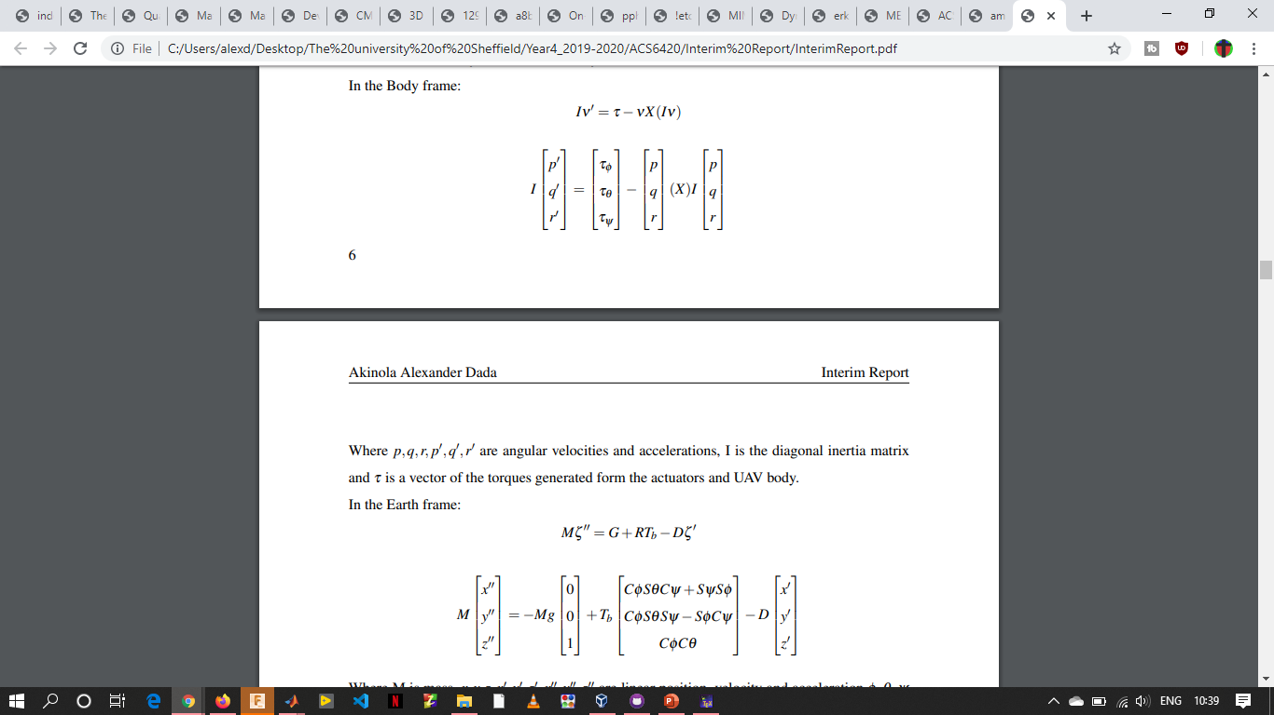
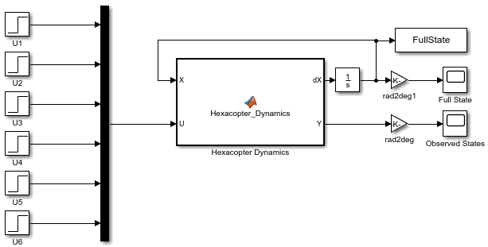
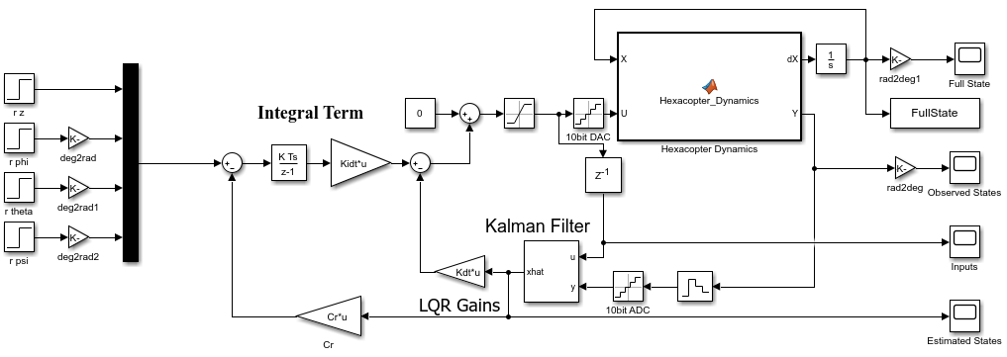
Thus Far….
Mathematical model.
Simulation.
LQG.

Slide 6
Immediate Plan of Action
Finish the simulation with real system values
Finish LQG design.
PID design
Implement on embedded microprocessor unit.

